Slide 1
Stock Trading System
Mid-Build Deck
IFT 401 Information Technology Capstone, Fall 2026
Daniel Houser, Alex Ruebush, Kyle Kishineff
October 2026
Notes:
Hi everyone, I'm Kyle Kishineff. Along with Daniel Houser and Alex Ruebush, I'm presenting the mid-build update for our Stock Trading System, our IFT 401 capstone project.

Slide 2
Agenda
Project concept and tools
Build vs. design
Functions completed
Problems and our plan
Roadmap
Notes:
First the project concept and our tools, then whether the build matches the design. Then the functions we've completed with screenshots, the problems we ran into and our plan for what's still open, and finally the roadmap.

Slide 3
Our technology solution
In one sentence
A web-based stock trading simulator where stockbrokers in training buy and sell stocks at randomly moving market prices, and administrators create stocks and control market hours.
Web front end, Node.js REST API, PostgreSQL database
Notes:
In one sentence: our solution is a web-based stock trading simulator where stockbrokers in training buy and sell stocks at randomly moving market prices, and administrators create stocks and control market hours. It's a client/server application: web pages, a Node.js REST API, and a PostgreSQL database.

Slide 4
Stakeholders and target audience
Customers (target audience)
Stockbrokers in training. They create an account, buy and sell at market price, cancel pending orders, manage cash, and review their portfolio and history.
Administrators
Create stocks with a company name, ticker, volume and initial price, and control market hours, the weekday schedule and holidays.
The company and its IT department
The company needs a safe way to train brokers without real money at risk. IT designs, builds and maintains the system.
Instructor and course staff
Evaluate whether the build meets the business case and matches the design we documented in the SAD.
Notes:
Our target audience is stockbrokers in training, who are the customers. Administrators create stocks and control market hours and the schedule. The company is the sponsor, since it needs a safe way to train brokers without real money at risk, and its IT department builds and maintains the system. Our instructor and course staff evaluate the build against the business case and our design.

Slide 5
Development tools and environment
Layer | What we use | Why we chose it
Languages | JavaScript (Node.js), HTML, CSS, SQL | One language across back end and front end; SQL fits relational trade data
Back end | Node.js, Express, bcryptjs, jsonwebtoken | Quick REST API; bcrypt hashes passwords; JWT gives stateless login
Database | PostgreSQL 16 in Docker Compose | ACID transactions keep orders, holdings and cash consistent; identical for every teammate
Front end | Static HTML, CSS and JavaScript pages | Lightweight, no framework; one api.js file talks to the API
Collaboration and testing | GitHub branches and pull requests, VS Code, Postman and PowerShell, Discord | Reviewed merges stop teammates overwriting each other; routes are tested without the front end
Target cloud | AWS Free Tier: EC2, RDS, S3, CloudWatch, Route 53 | Free-tier MVP; deployment scheduled for Nov 2 to 13
Notes:
Our languages are JavaScript on Node.js for the API, plain HTML, CSS and JavaScript for the pages, and SQL for the database. The API uses Express, bcryptjs to hash passwords, and jsonwebtoken for login. PostgreSQL 16 runs in Docker Compose, so every teammate gets an identical database. We collaborate through GitHub branches and pull requests, edit in VS Code, test routes in Postman and PowerShell, and coordinate on Discord. In November we deploy the same stack to the AWS Free Tier.

Slide 6
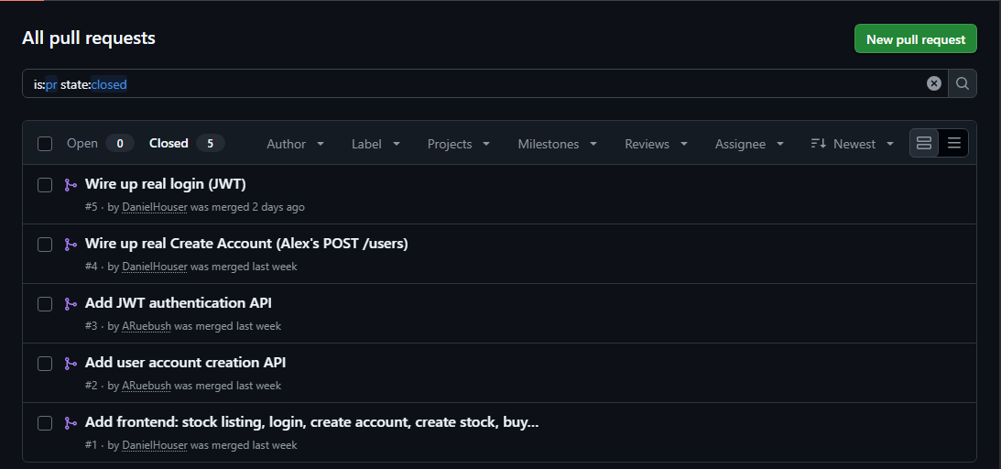
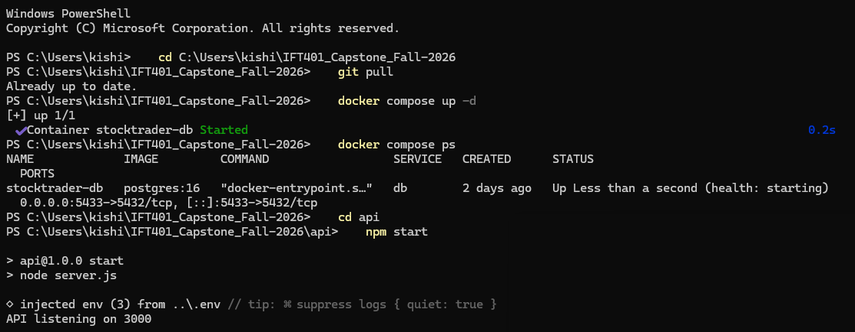
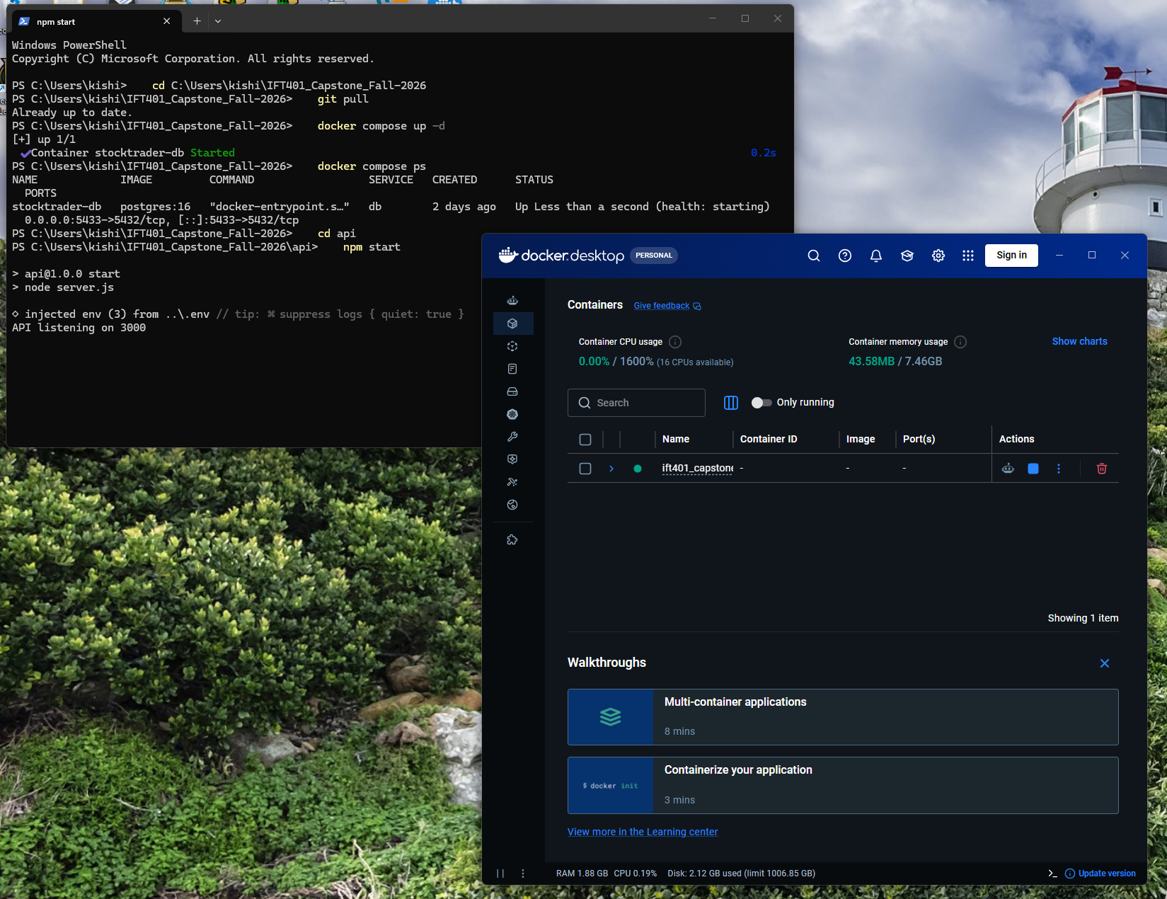
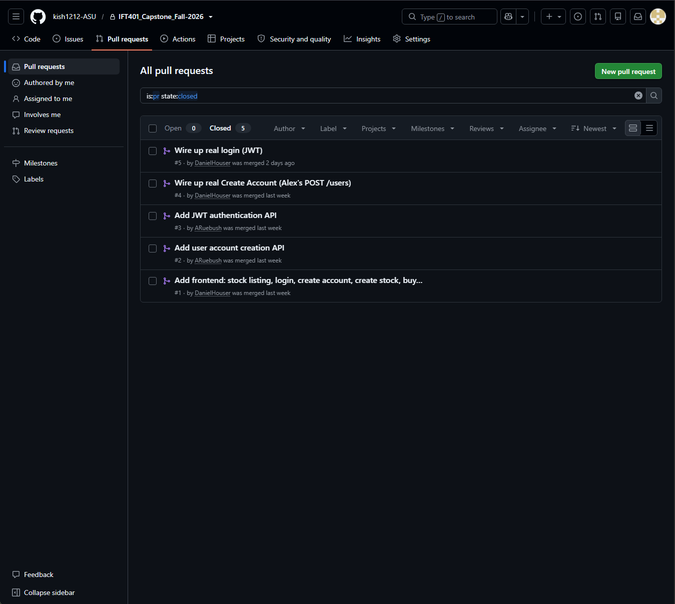
Our environment in action
Closed pull requests: all five merged
Database container and API running locally
Notes:
On the left, our GitHub pull requests: every change goes through a feature branch and a reviewed merge. On the right, the PostgreSQL container running in Docker and the API listening on port 3000. Anyone on the team can recreate this in four steps from the README.

Slide 7
Build vs. design
Area | Original plan, and the change we made | Why we changed it
Stock price data | ERD had current_price only. Added opening_price, day_high and day_low to the stocks table. | Business case requires open, high and low; new stocks never show $0.00
Placing orders | First API draft executed orders instantly. Orders are now saved as pending and executed by a server timer seconds later (in the API contract; build is next). | Business case lets a customer cancel before execution
Authentication | Session or token left open. JWT bearer tokens in the Authorization header (built and merged). | Pages and API are on different origins; no sessions table needed
Unchanged | Three-tier architecture, PostgreSQL, customer and admin roles, free-tier AWS plan. | The build matches the design in structure
Notes:
Does the build match the design? In structure, yes. We kept the three-tier architecture, PostgreSQL, the customer and admin roles, and the free-tier AWS plan. We made three deliberate changes. First, our ERD had only a current price on stocks, but the business case requires opening price, high, and low, so we added those columns. Second, our first API draft filled orders instantly, which made cancelling impossible, so orders are now saved as pending and will be executed by a server timer; that executor is the next build. Third, we left session versus token open, and chose JWT tokens because our pages and API sit on different origins.

Slide 8
Functions completed
Function | What it does | Status
1. View available stocks (GET /stocks) | Lists every active stock with price, change, volume and market cap; a click shows open, high and low. Read live from PostgreSQL and refreshed every 5 seconds. | Done
2. Create a user account (POST /users) | Saves a customer with a bcrypt-hashed password that is never returned. Missing fields return 400; duplicates return 409. | Done
3. Log in (POST /auth/login, GET /users/me) | Returns a signed token valid for 4 hours. Protected routes need a Bearer token; bad credentials return 401. The login page uses it. | Done
4. Random stock price generator (background job) | Moves every active stock's price a little every few seconds while the market is open, and keeps the day's open, high and low current. | Done
Notes:
We've completed four functions on the real API and database. One, viewing the available stocks, read live from PostgreSQL and refreshed every five seconds. Two, creating a user account: the password is stored as a bcrypt hash and never returned, with a 400 for missing fields and a 409 for duplicates. Three, logging in: the API returns a signed token valid for four hours, protected routes require it, and the login page uses it. Four, the random price generator, a background job that moves prices while the market is open.

Slide 9
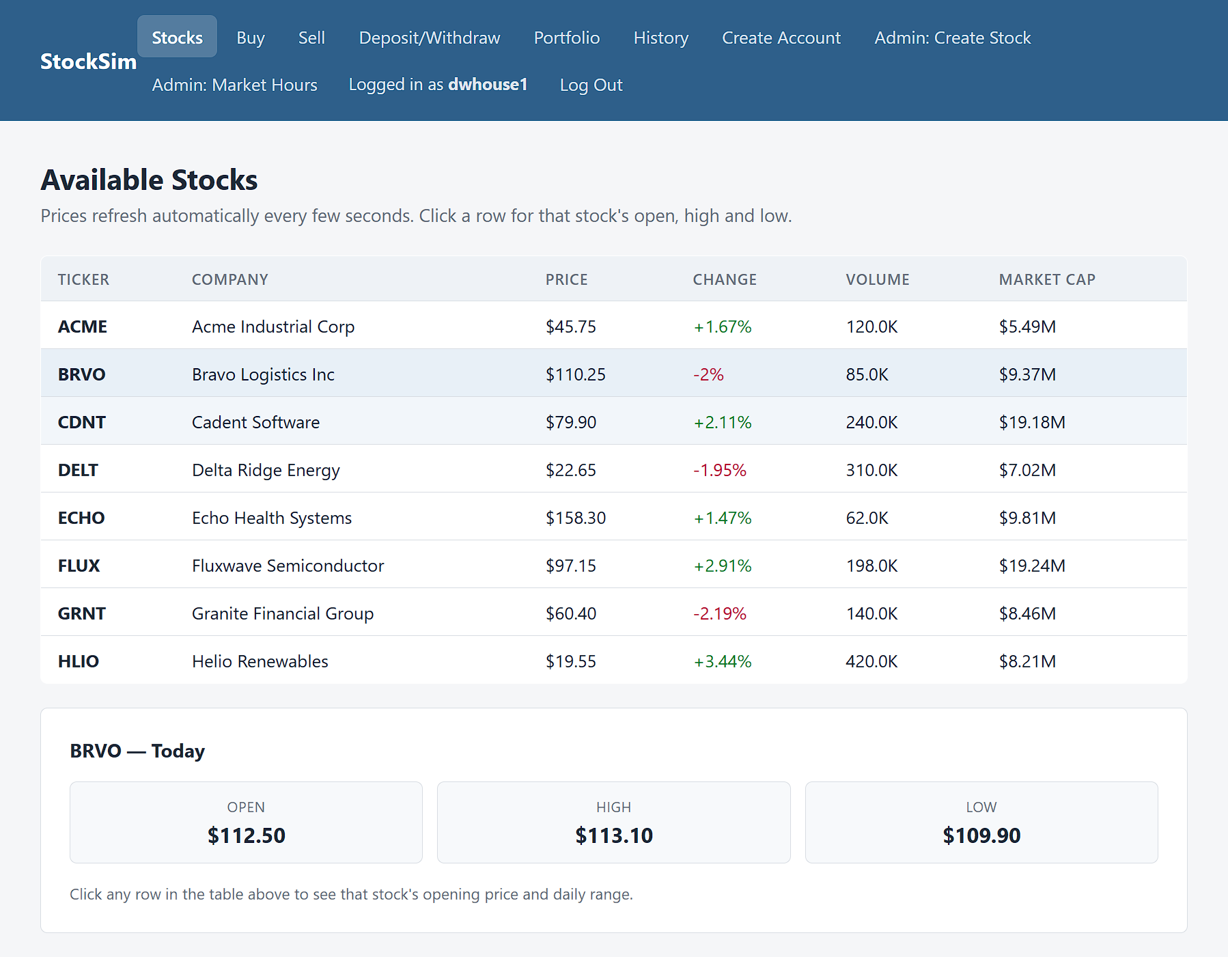
Function 1: View available stocks
What it does
Lists every active stock with its price, change, volume and market cap. Click a row to see its open and day high and low.
How it works
The page calls GET /stocks and refreshes every 5 seconds. The API reads PostgreSQL and computes market cap as volume x price.
Why it matters
It is the starting point for every trade, with real database values.
Notes:
This is the stock listing page. It shows every active stock with its ticker, company, current price, percent change, volume, and market cap. When I click a row, the panel underneath shows that stock's opening price and the day's high and low. The page calls GET /stocks and asks again every 5 seconds, the API reads the stocks table in PostgreSQL, and market cap is calculated as volume times price. This is real database data, not mock data.

Slide 10
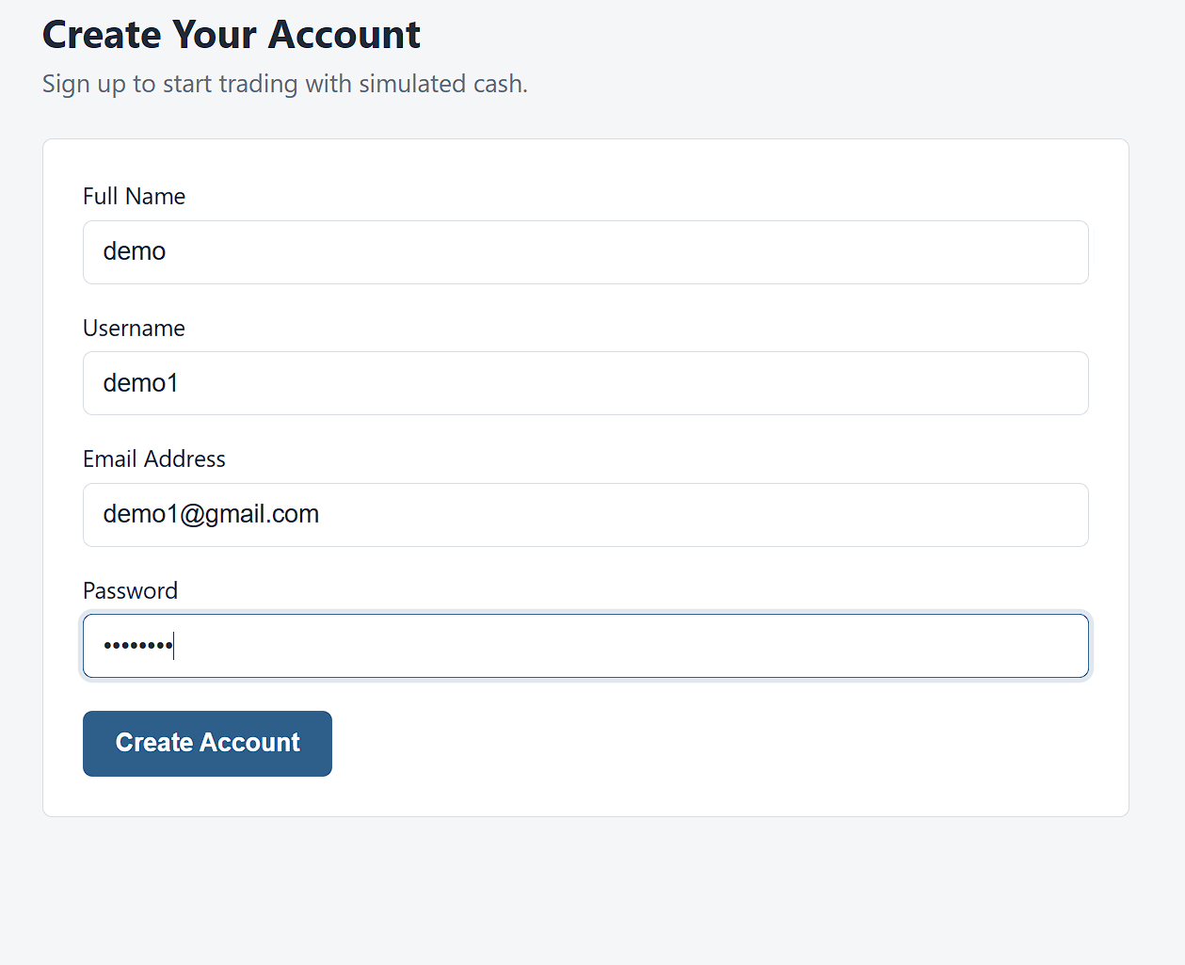
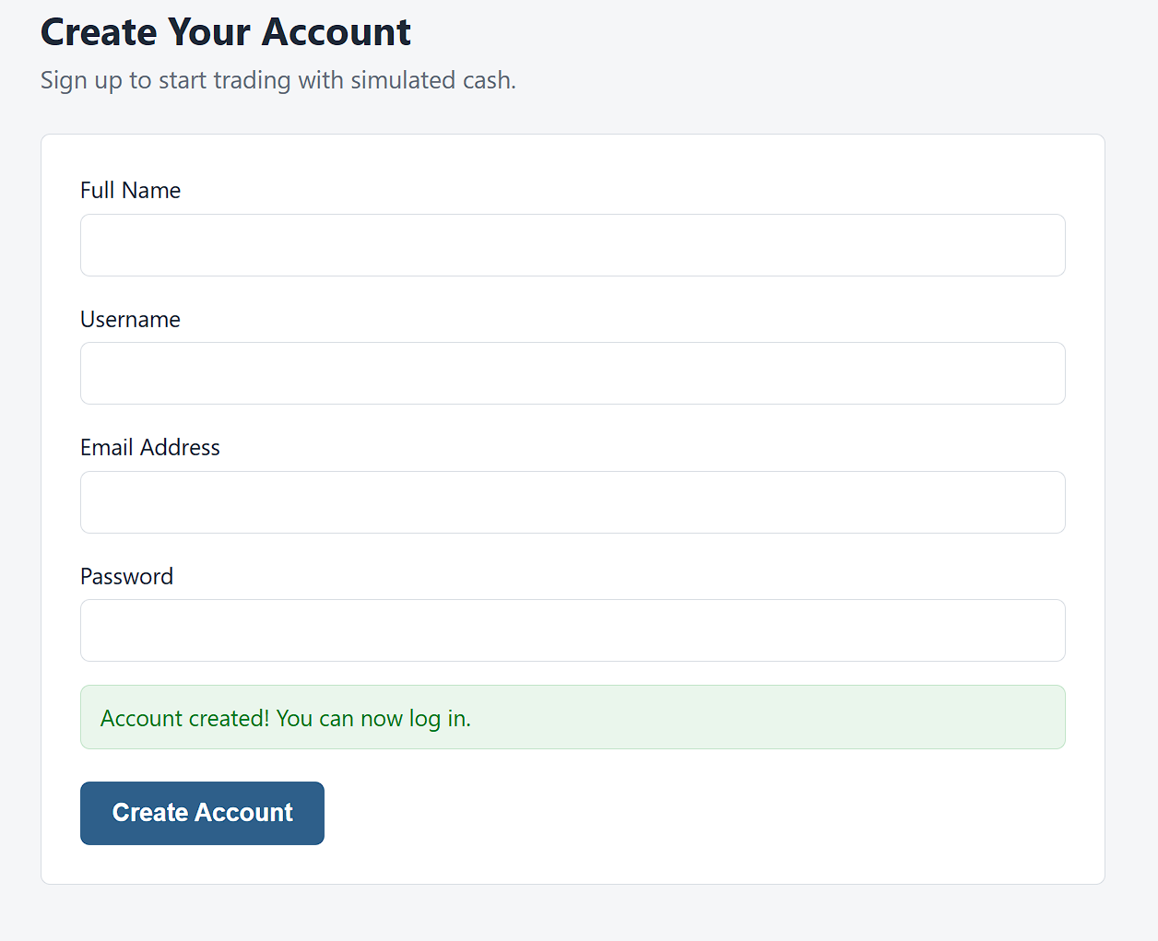
Function 2: Create a user account
What it does
A new customer enters a full name, username, email and password to create an account.
How it works
The page calls POST /users. The API hashes the password with bcrypt and saves a customer with $0.00 cash.
Checks
A duplicate username or email returns 409. Missing fields return 400. The duplicate case is shown on the next slide.
1. Form filled in
2. Account created
Notes:
The second function is creating an account. A new customer enters a full name, username, email, and password. The page calls the real POST /users endpoint. The password is hashed with bcrypt, and new accounts start as customers with zero cash. After a successful sign-up the page shows a green confirmation. A duplicate username or email gets a 409 and missing fields get a 400. I show the duplicate case on the next slide.

Slide 11
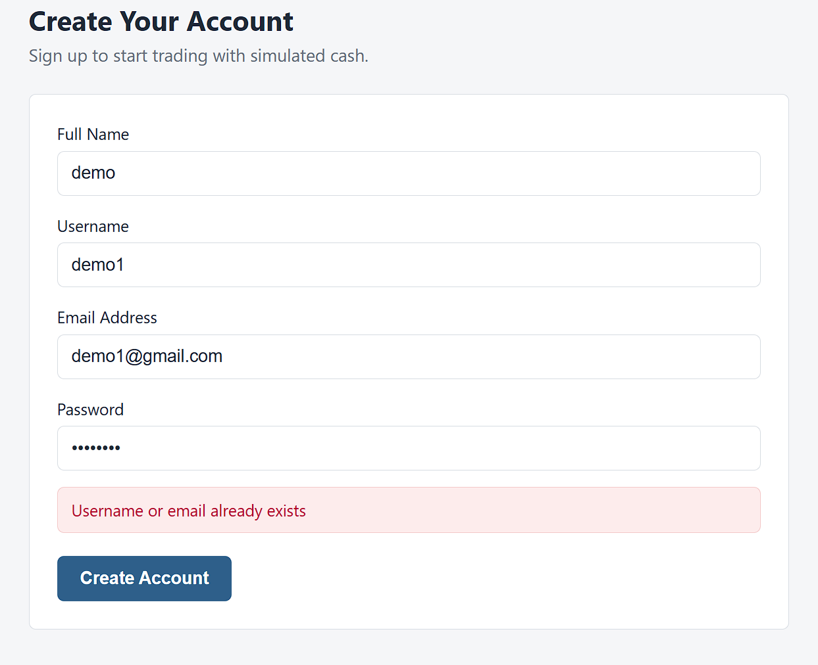
Function 2: Validation checks
What it does
The server rejects a sign-up that reuses a username or email, and the page shows the server's message in red.
How it works
POST /users returns 409 for a duplicate and 400 for missing fields. The form also requires every field and a password of at least 8 characters.
Why it matters
Each username and email belongs to exactly one account, so every login points to one customer.
Notes:
Here I submit the same username again. The API answers 409 and the page shows its message, Username or email already exists, so no two customers can share a username or email. The form itself also requires every field and a password of at least 8 characters.

Slide 12
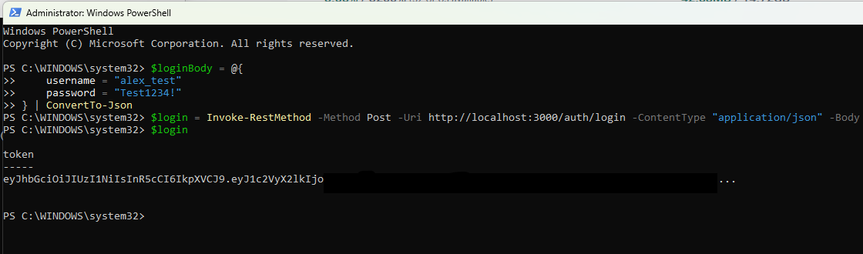
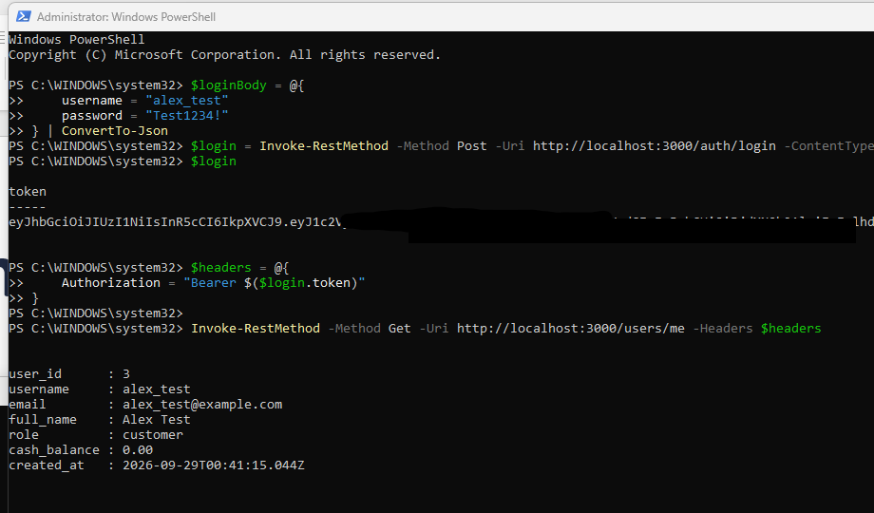
Function 3: Log in
What it does
A registered customer logs in and is recognized on every protected request.
How it works
POST /auth/login verifies the password and returns a JWT valid for 4 hours. GET /users/me returns the user and cash balance for a valid Bearer token. The login page is wired to it.
Checks
A wrong password or missing token returns 401.
POST /auth/login returns JWT
Token partially hidden for safety
GET /users/me with Bearer token
User, role, and balance returned
Notes:
The third function is logging in. POST /auth/login checks the password with bcrypt and returns a JWT valid for four hours. GET /users/me uses that token, sent as a Bearer header, to return the logged-in user and their cash balance. A wrong password or a missing or expired token returns 401. The login page on the site now calls this endpoint instead of the old mock accounts.

Slide 13
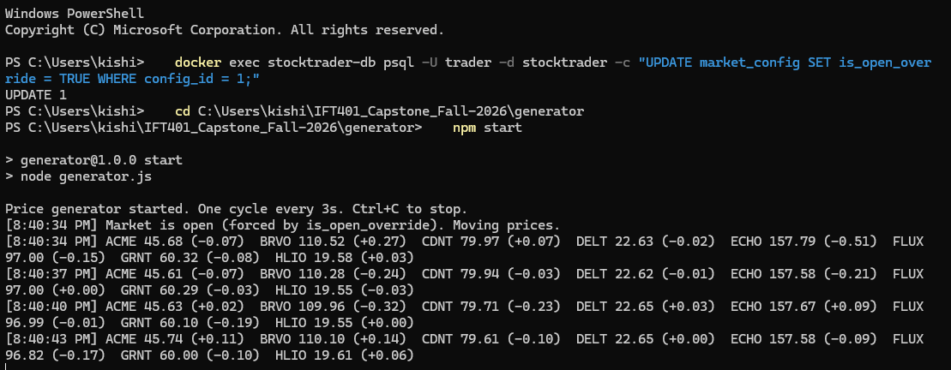
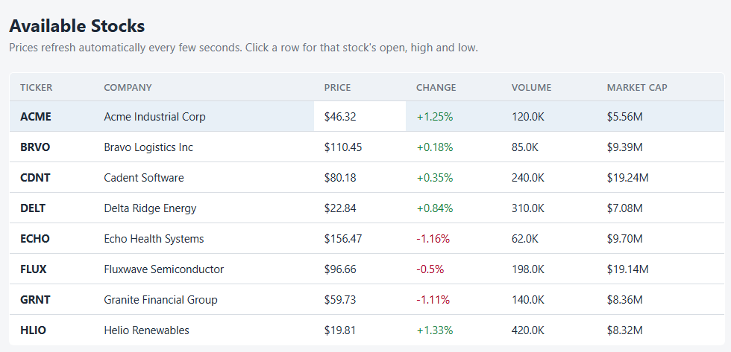
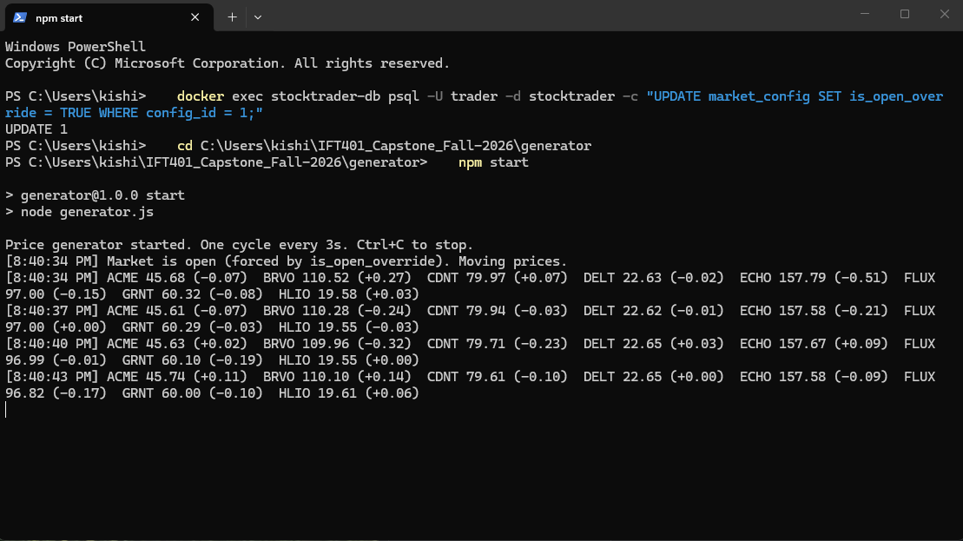
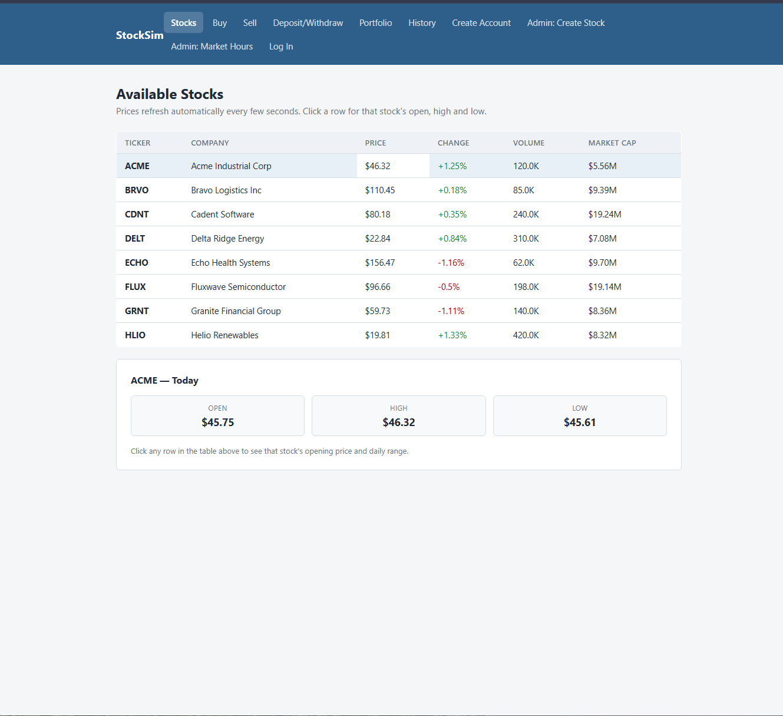
Function 4: Random stock price generator
What it does
Moves every active stock's price up or down a little every 3 seconds while the market is open, and keeps the day's open, high and low current.
How it works
A separate job reads the market hours from the database and updates the prices directly. The listing page refreshes every 5 seconds, so the prices move on screen.
Checks
Outside market hours it waits. Prices stay in whole cents and never reach zero.
Notes:
The fourth function is the random price generator. It's a separate background job that checks the market hours in the database and, while the market is open, nudges every active stock's price up or down by a small amount every few seconds. It also keeps the day's opening price, high and low current. Here it's running in the terminal, and the stock listing page refreshes every five seconds, so you can see the prices change on screen. Outside market hours it just waits.

Slide 14
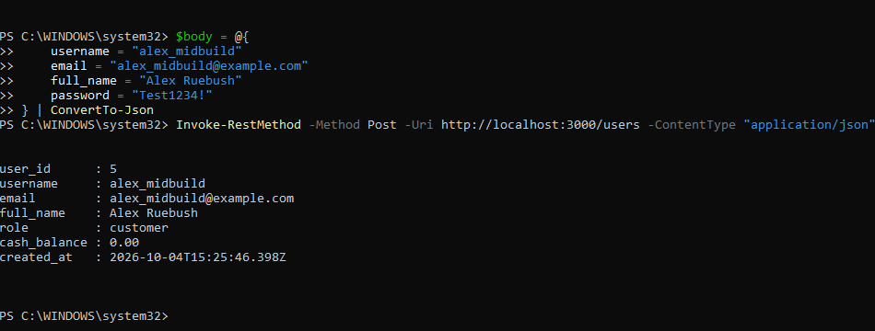
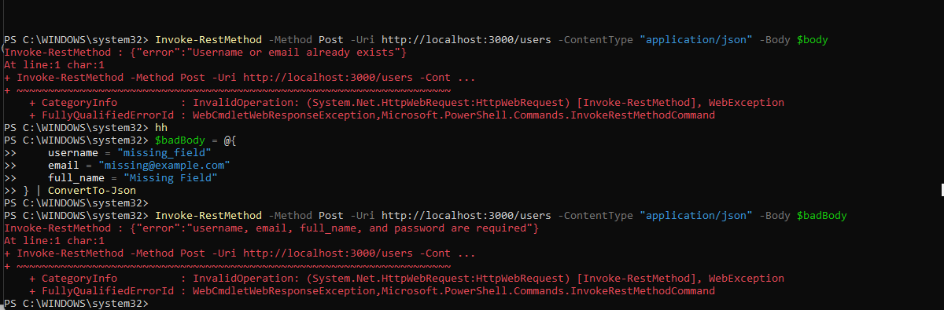
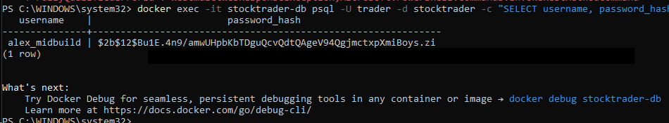
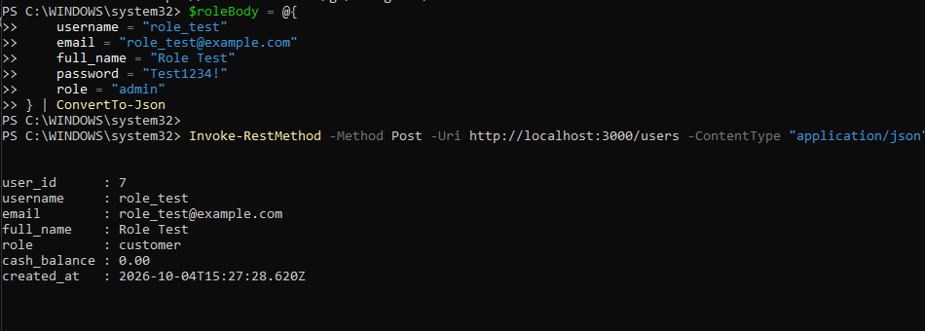
Testing the routes
Every response follows api-contract.md
201 account created
No password_hash in the body
409 duplicate and 400 missing field
Both error responses visible
bcrypt hash in the database
Stored as a hash, not the original password
Request with role admin
Response still says role customer
Notes:
We tested these routes against our API contract. A valid request returns 201 with no password hash. A duplicate username or email returns 409, and missing fields return 400. In the database, the password is a bcrypt hash, not the original text. And we tested that sending a role of admin in the request still creates a customer, because the server sets the role.

Slide 15
Data model
Table | What it holds | Key fields
users | Customers and admins; new accounts start as customers with $0.00 cash | username, email, full_name, password_hash, role, cash_balance
stocks | Listed stocks with the live price and the day's open, high and low | ticker, company_name, current_price, opening_price, day_high, day_low, volume
holdings | What each user owns, one row per user and stock | user_id, stock_id, quantity, avg_cost_basis
orders | Buy and sell requests, cancelable while pending | order_type, quantity, status, executed_price, canceled_at (executes_at and reject_reason are next)
transactions | Completed buys, sells, deposits and withdrawals | transaction_type, price_per_share, total_amount, balance_after
market_config | One row: open and close time, time zone, trading days and holidays | market_open, market_close, timezone, trading_days, holidays
Notes:
The data lives in PostgreSQL, started with Docker Compose so every teammate gets an identical database. We have six tables: users, stocks, holdings, orders, transactions, and market config. Money is stored as NUMERIC to avoid rounding errors. This sprint we added opening price, day high, and day low to stocks. Next, orders needs an execution time and a reject reason so pending orders can be executed and canceled.

Slide 16
Build status
As of Oct 8. Mock pages share the API contract's field names.
Feature | Back end | Front end | Status
Stock listing | Real | Real | Done
Create account | Real | Real | Done
Login and session | Real (JWT) | Real | Done
Price generator | Real (job) | n/a | Done
Create stock (admin) | Next | Mock | Next
Buy, sell and cancel | Next | Mock | Next
Deposit and withdraw | Next | Mock | Next
Portfolio and history | Next | Mock | Next
Market hours | Next | Mock | Next
Notes:
The stock listing, account creation, login, and the price generator are real end to end. The remaining pages are built and demoable on mock data that uses the same field names as our API contract, so converting each one to the real route means changing one file, not the page.

Slide 17
Problems we solved
Problem | What we did | Status
Cancel was impossible: our first API draft filled orders instantly, so nothing was ever pending. | Orders will be saved as pending with an execution time; a server timer executes them and cancel only acts on pending orders (in the API contract; build is next). | Designed
Login across origins: static pages and the API sit on different origins, so cookies need credentialed CORS. | Switched to JWT bearer tokens in the Authorization header, with 4-hour expiry and no sessions table. | Solved
New stocks showed $0.00 for open, high and low because the ERD lacked those fields. | Added opening_price, day_high and day_low to stocks; the contract has POST /stocks set all of them to the initial price (route is next). | Solved
Teammates were blocked on GitHub invites and slow reviews. | Reissued the invite, made one reviewer and merger, and added a "Who owns what" section to the API contract. | Solved
Notes:
We hit four problems and solved or designed fixes for each. Our first API draft filled orders instantly, so nothing was ever pending and cancel could never work; orders will now be saved as pending and a server timer executes them. Our pages and API sit on different origins, which makes cookies awkward, so we switched to JWT bearer tokens. New stocks showed a zero price for open, high, and low because our ERD lacked those fields, so we added them. And teammates got blocked on GitHub invites and slow reviews, so we reissued the invite, made one reviewer, and documented who owns what in the contract.

Slide 18
Open problems and our plan
Open problem | Plan to fix it | Owner
Trading, cash, portfolio and history pages still run on mock data | Swap in each real route as it lands; only api.js changes. Done before the Nov 2 AWS deployment. | Daniel
The order executor and market-hours routes are not merged yet | Finish and merge them, then connect the buy and sell pages and the market hours page. | Kyle
The schema and seed data lag the contract: orders has no executes_at, reject_reason or rejected status, and the seed accounts have placeholder password hashes | Add the order columns and extend the status check; give the seed real bcrypt hashes so admin and testuser can log in. | Alex
Admin-only routes have no role check yet | Add a requireAdmin middleware that returns 403 for non-admins, alongside POST /stocks and PUT /market. | Alex, Kyle
Market hours must follow Eastern time, not the viewer's clock | Compute open or closed on the server from hours, weekdays and holidays in America/New_York. | Kyle
Notes:
Here's what's still open and our plan. The trading, cash, portfolio, and history pages still run on mock data, so Daniel swaps in each real route as it lands, and only one file changes. The order executor and the market-hours routes still need to be finished and merged, and then the buy and sell pages connect to them. The schema and seed data need the new order columns and real password hashes. Admin-only routes need a role check, and market hours must follow Eastern time, so the server will calculate open or closed rather than trusting the viewer's clock.

Slide 19
Roadmap
When | Milestone | Who
Oct 19 | Mid-build deck and video due | Whole team
Now to Nov 2 | Finish the remaining routes, connect every page to the real API, and test end to end | Whole team
Nov 2 to 13 | Deploy to AWS Free Tier | Kyle
Nov 16 to 22 | Final build deck and video | Whole team
Nov 22 to 29 | Final deliverables: plan and evaluation | Whole team
Notes:
Today is the mid-build. Between now and early November we finish the remaining routes and connect every page to the real API. Kyle then deploys to the AWS Free Tier from November 2nd through the 13th, the final build deck and video follow the week of November 16th, and the final deliverables are due by the end of November.

Slide 20
Questions?
Thank you for watching
Notes:
To wrap up: our environment is established, three functions run on the real API and database, and the rest of the system is built against the same contract. Thanks for watching, and we're happy to take questions.

